Slide 1
Hello World
Integrating Visual Studio Code, Python, Git, and GitHub
By Cassie Smith

Slide 2
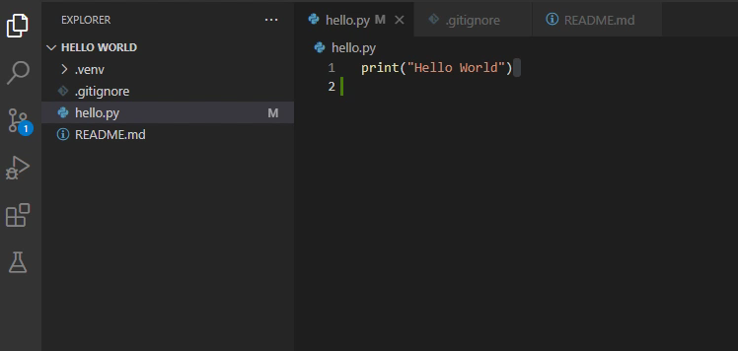
VS Code, Python, Git, and GitHub

Slide 3
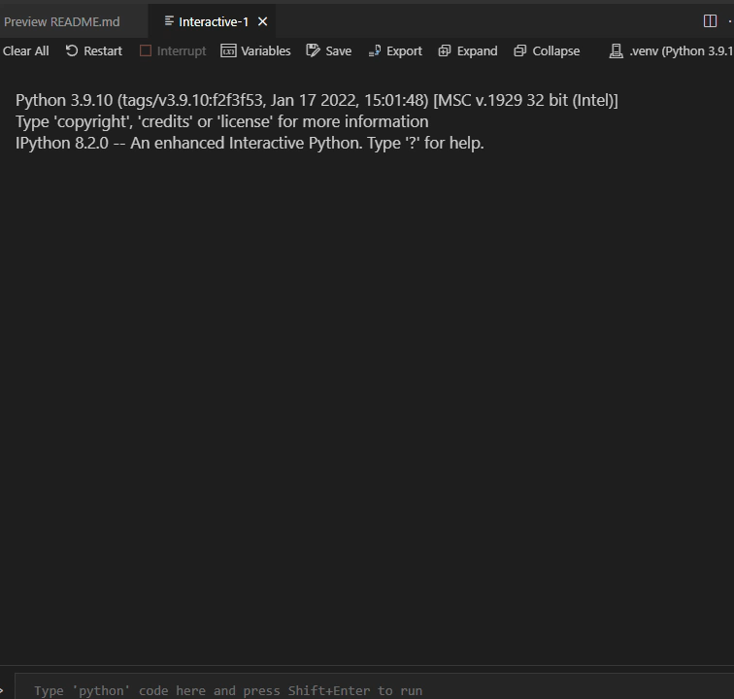
Working Code

Slide 4
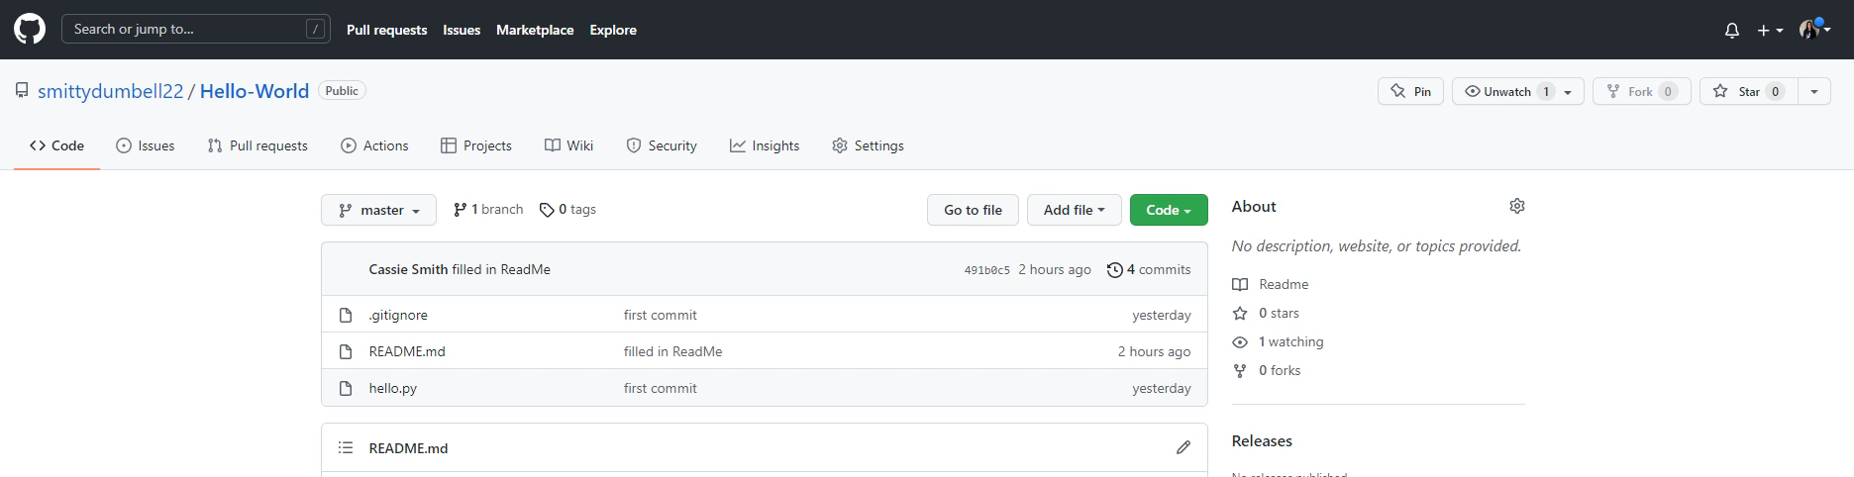
Linked to GitHub

Slide 6


